Slide 1


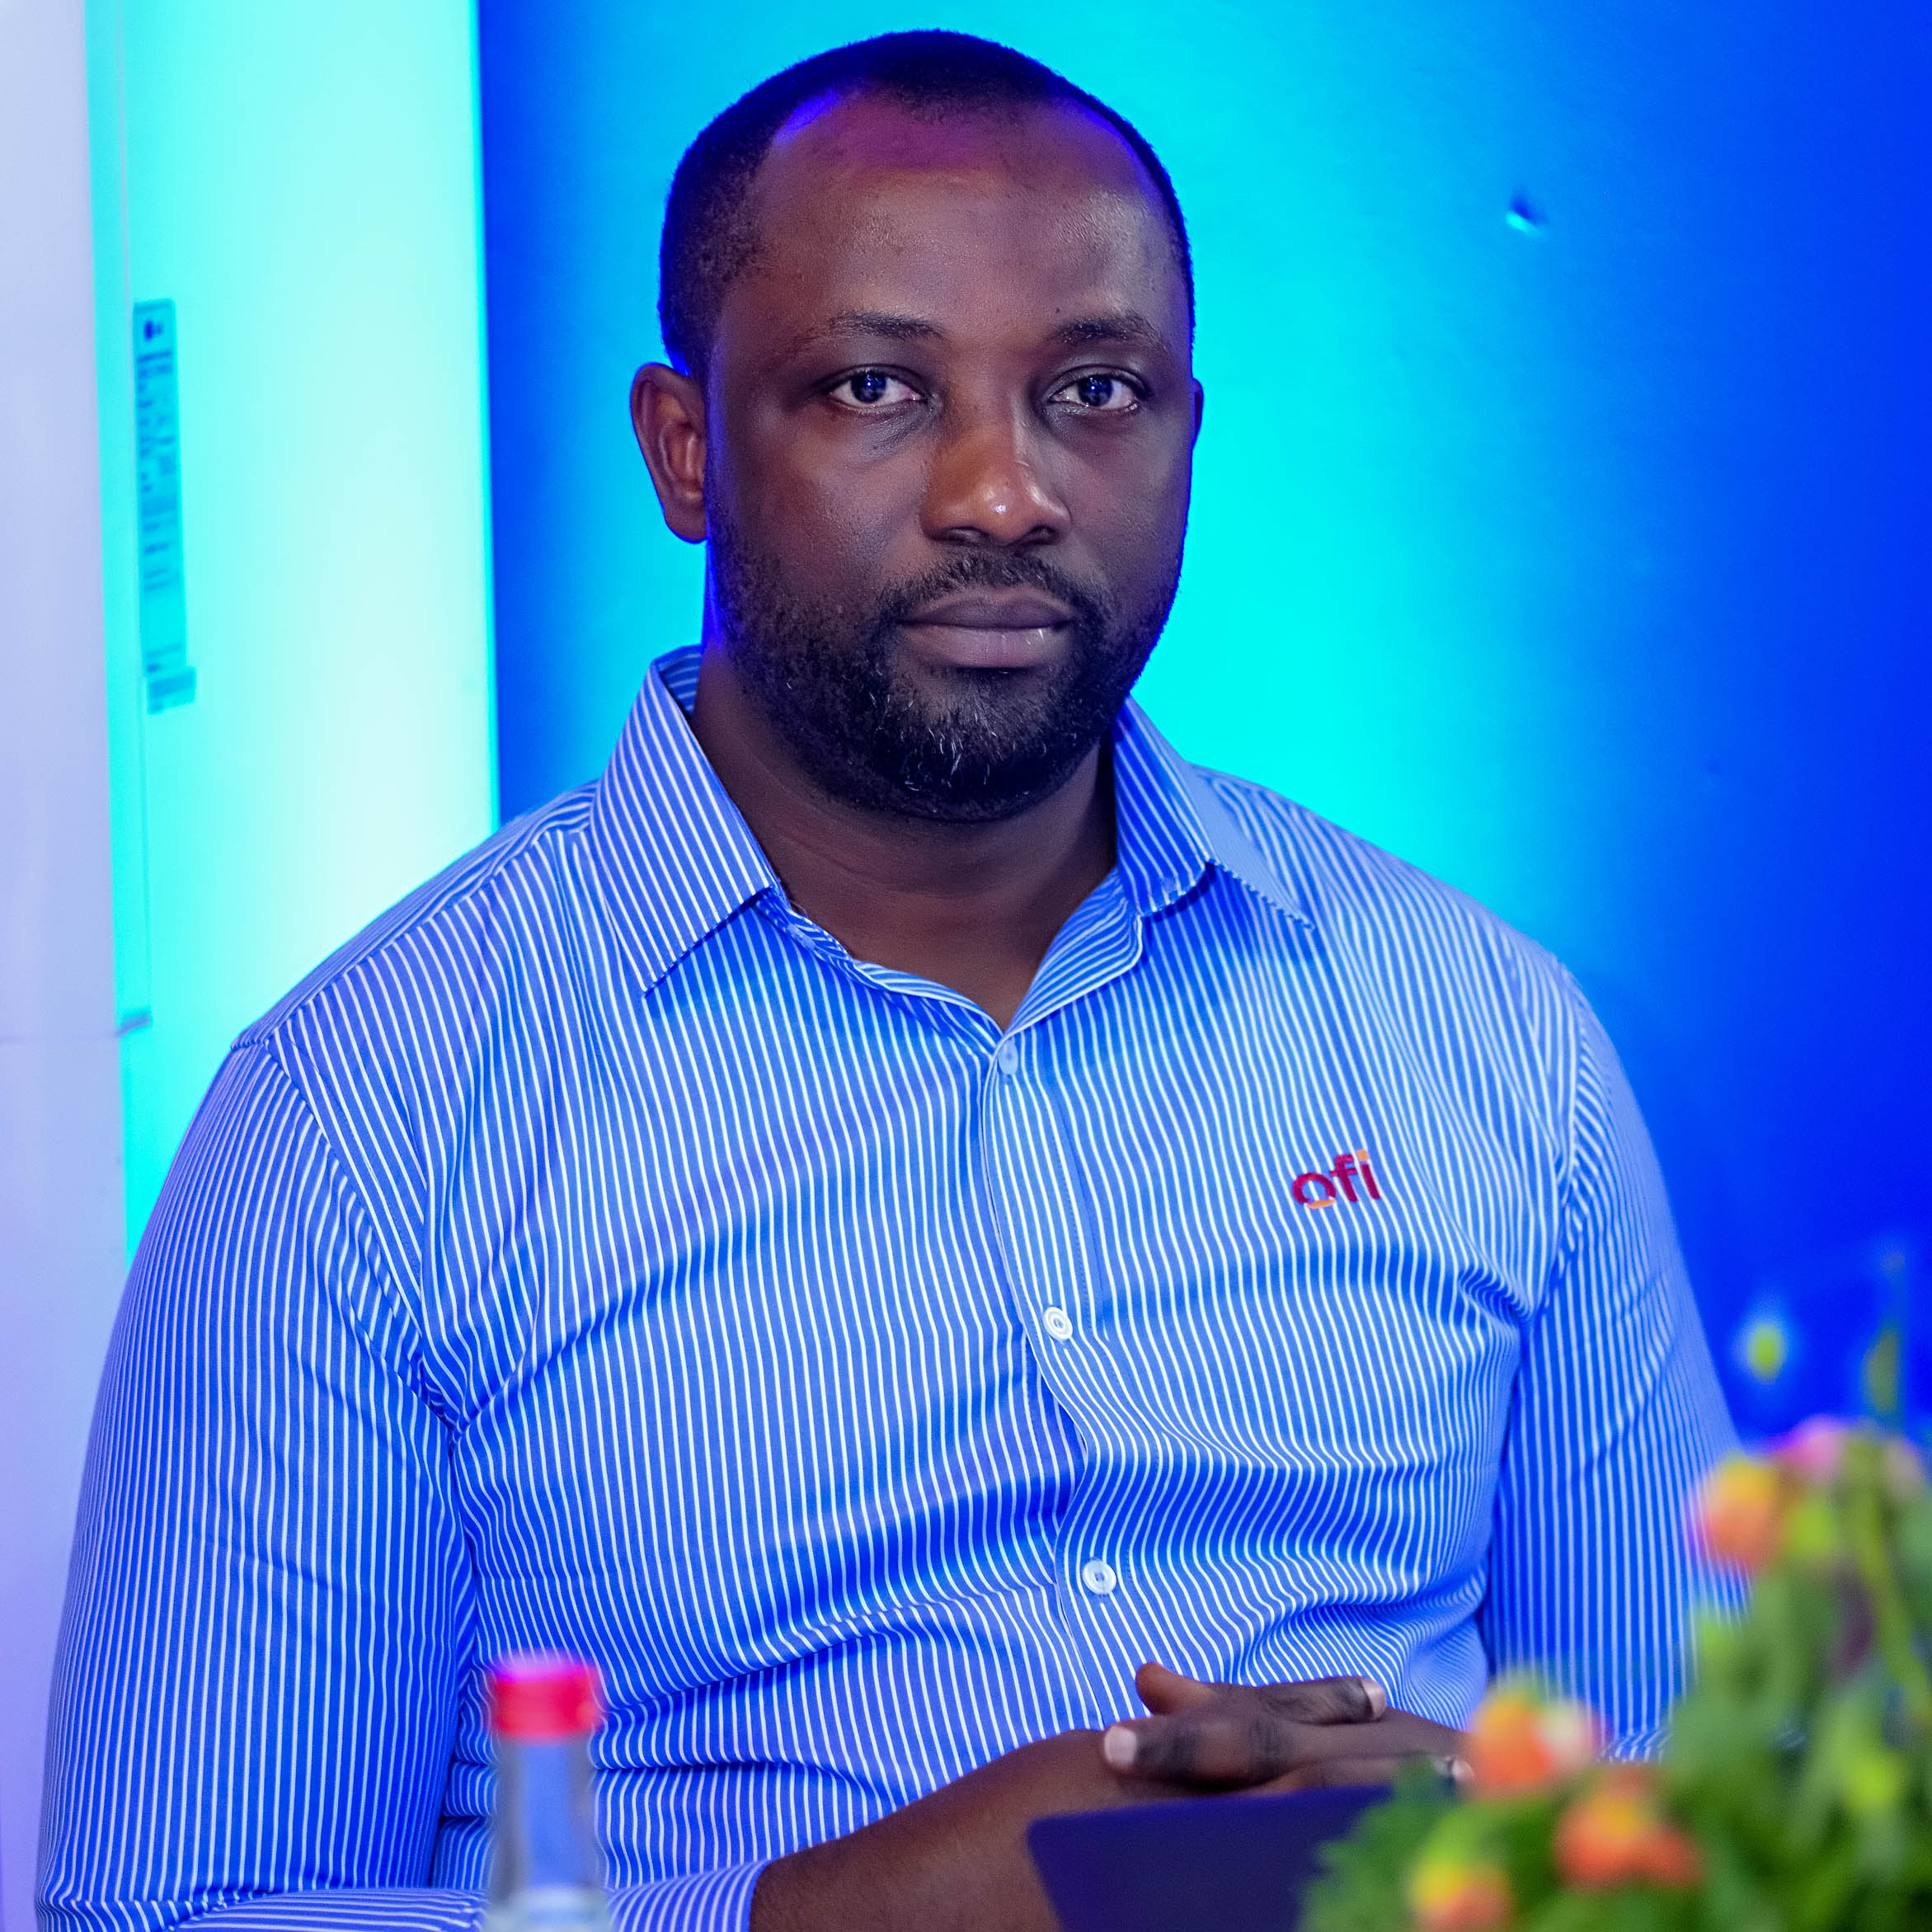
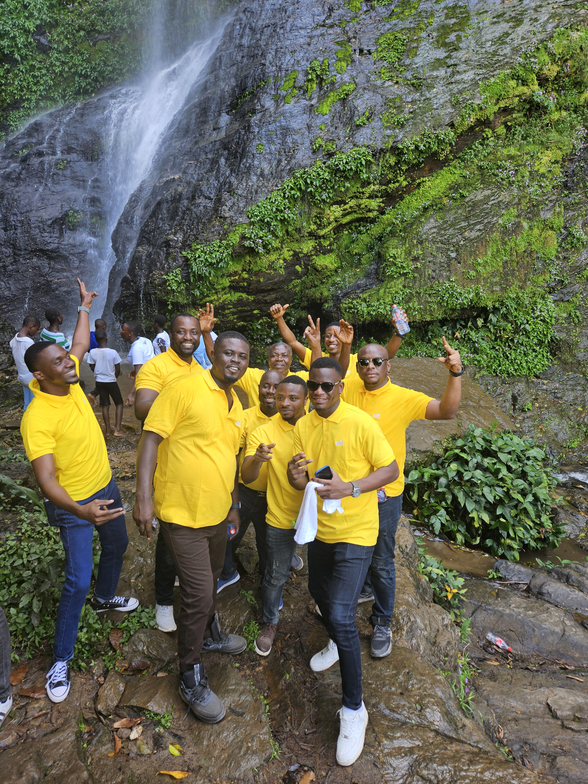
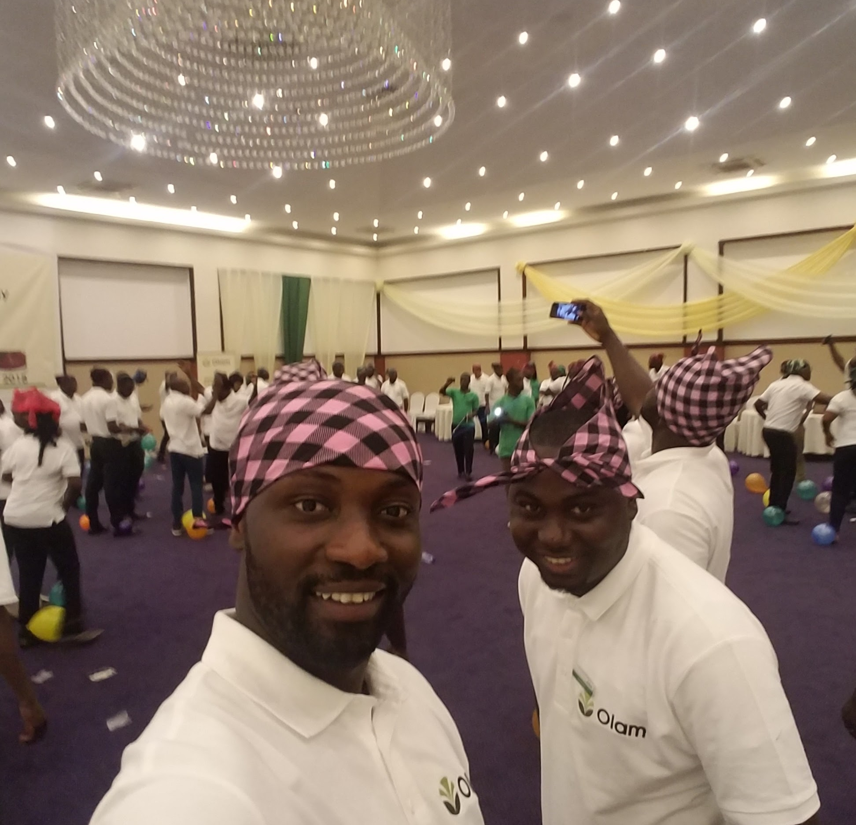
Getting to Know Me
Work
Personal
My role
Compliance and Assurance Manager
Significant others / family members / furry friends in my life
Penninah – significant other/ Maame Konadu – daughter/mom.
Tenure in ofi/Olam
12 years
How I enjoy spending my free time
Indoor with family and friends
Previous companies I have worked at
PZ Cussons Gh. Ltd., Ghana Audit Service
My favorite / comfort food
Fufuo and Goat Light Soup
Why I joined ofi/Olam and what keeps me here?
Wanted to be part of a multi-national company with good reputation and strong growth potential. I enjoy the people and friendly relationship present in ofi. My role aligns with my skills and career goals.
My favorite song
Celestine Donkor – Only You
Michael Kusi
‘Micky’
I have gotten so attached to my phone, my children couldn’t help it but accepted it as their last and beloved sibling.
This is me outside work, doing stuff I enjoy in my life …

